Slide 1

The Project About Body Performance
Ahmed Tolba Ali Omara
Ahmed Mohamed Hamdy Sharaf
Ibrahem Mohamed Zenhom Ali Mohamed

Slide 2

Table of Content
Introduction
Data Cleanning
Data Wrangling
Analysis
Data visualization
Conclusions

Slide 3
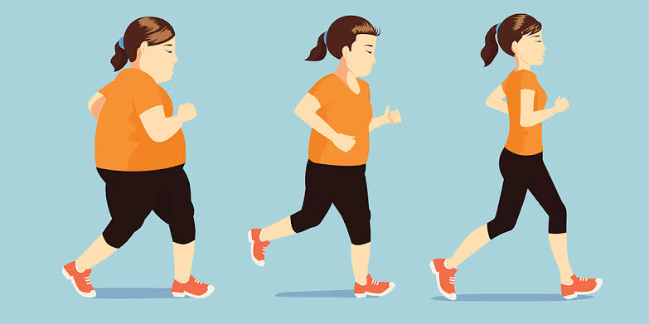
Introduction
In this project, we will talk about the effects of body performance:
“12 columns and 13,394 rows.” Among the factors we will talk about are age, gender, height, weight, fat percentage, diastolic, systolic,
gripforce, sit and bend forward, sit-ups counts, broad jump, and class.
We will study the effect of each of these factors on the rest of
the factors in some detail
by using (pandas, numpy, matplotlib).
Before the analysis of the dataset, data wrangling phase has been conducted to clean the data from unimportant columns, noisy data, and other problems. Before data wrangling phase, general properities about the dataset has been addressed.

Slide 4
Analysis of DataSet (question that is analyzed in the data set)
1-Information about Runtime of the body performance
2 –information about height_cm and weight_kg average of the body performance
3 –Count each Class of body performance in data set
4-Mean of height_cm and weight_kg
5-Number of body performance
6-Mean for Fitness
7-Fitness for all persons
8-Relationship between body_fat and class
9- Relationship between gender and number of person
10 – Correlation between age , weight_kg and gripFore

Slide 5
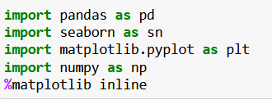
Data Wrangling
Tip:
Import package to use
In this section of the report, we will load in the data, check for cleanliness, and then trim and clean dataset for analysis. and cleaning way. We not will start with addressing General properities about the dataset.

Slide 6
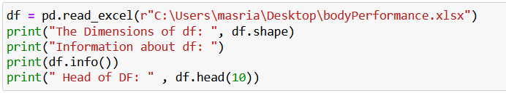
General Properties
Load xlsx file name bodyperformace
Dimensions of df
Information of df
First ten rows of df

Slide 7
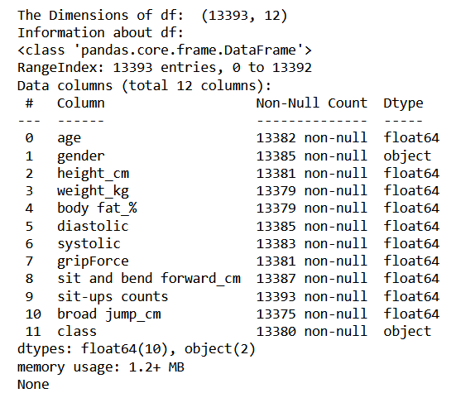
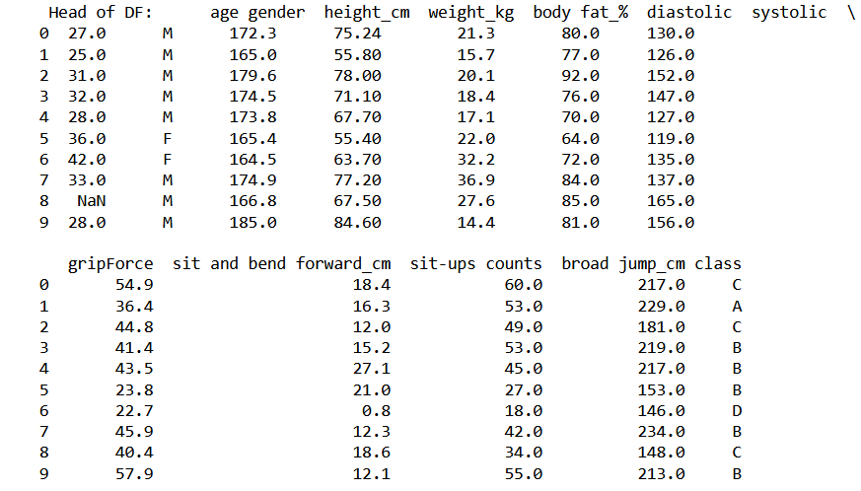
The output

Slide 8
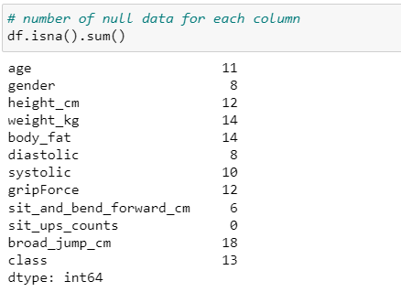
Data cleanning

Slide 9
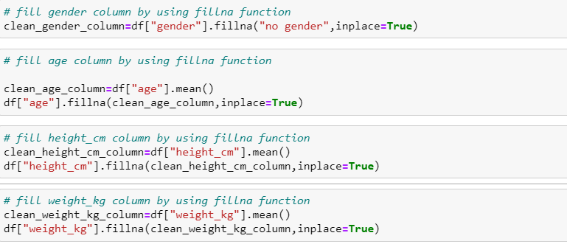
Data cleanning

Slide 10
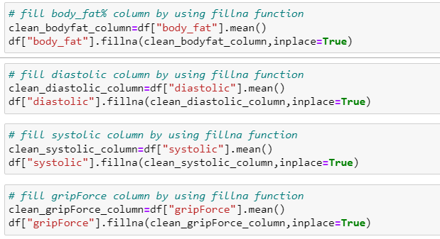
Data cleanning

Slide 11
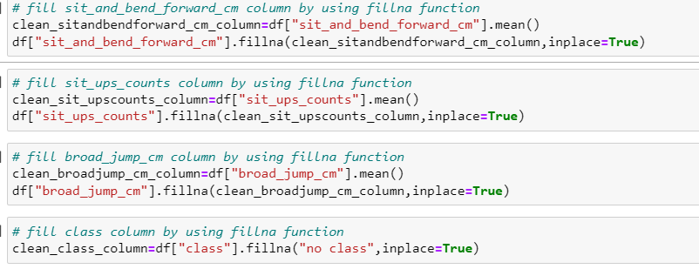
Data cleanning

Slide 12
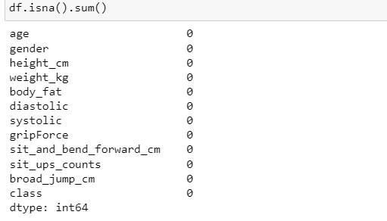
Data cleanning

Slide 13
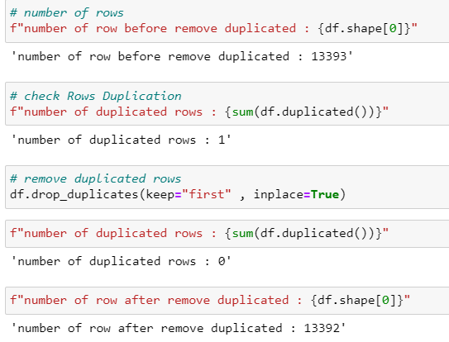
Data cleanning

Slide 14
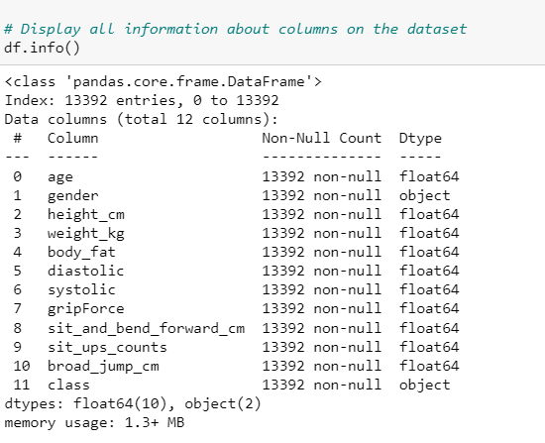
Data cleanning

Slide 15
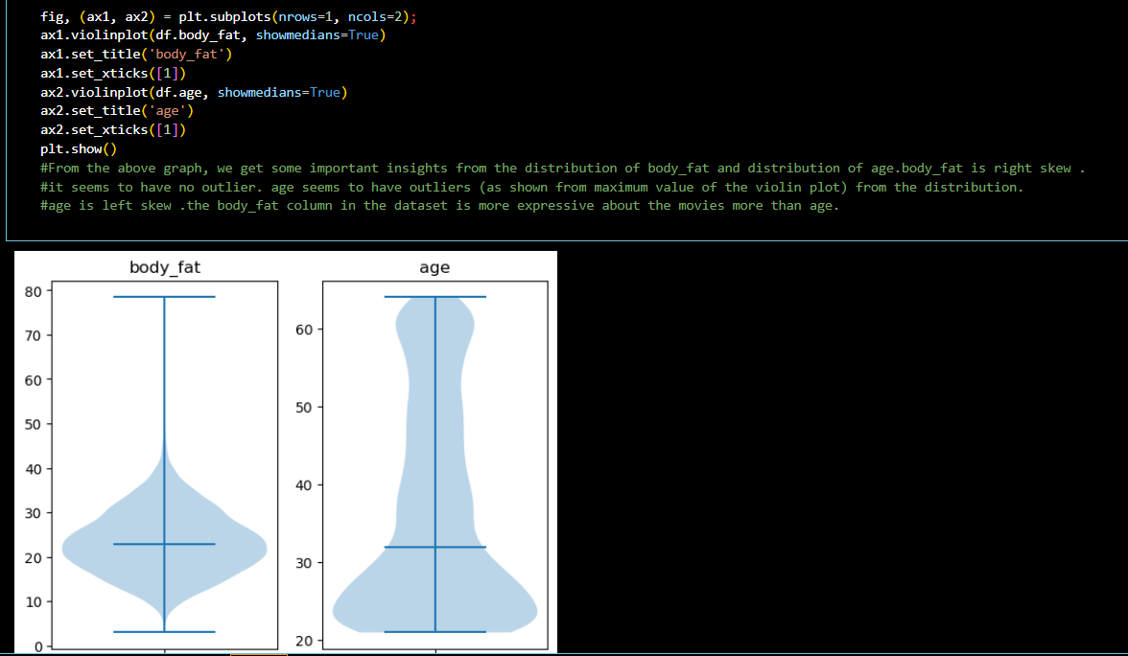
Visualization

Slide 16
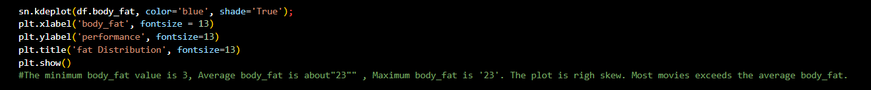
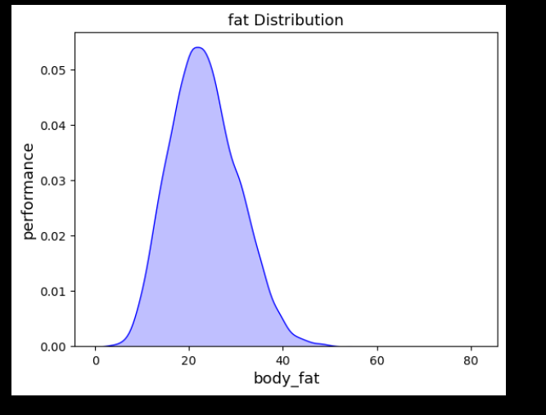
Visualization

Slide 17
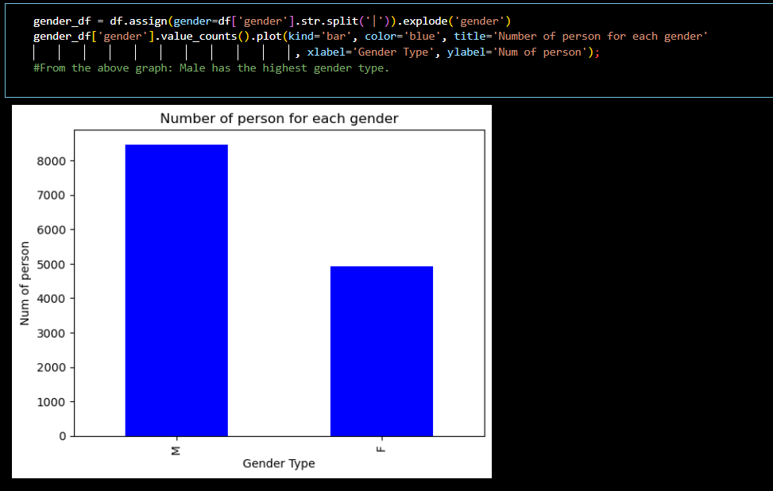
Visualization

Slide 18
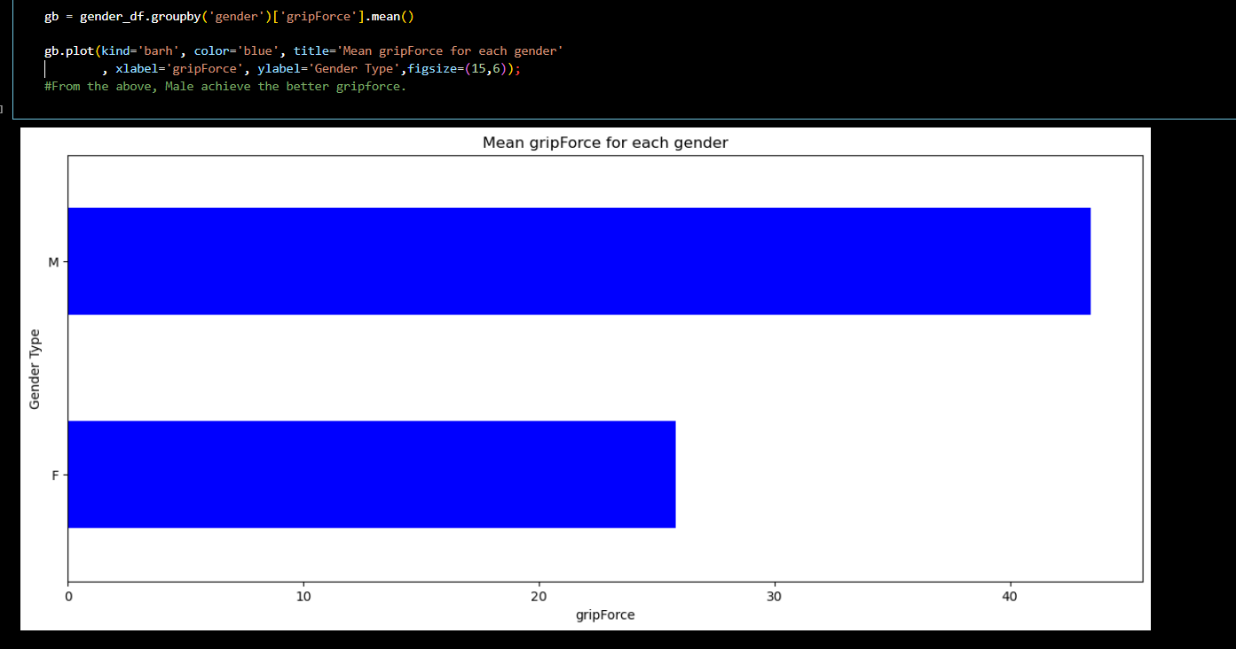
Visualization

Slide 19
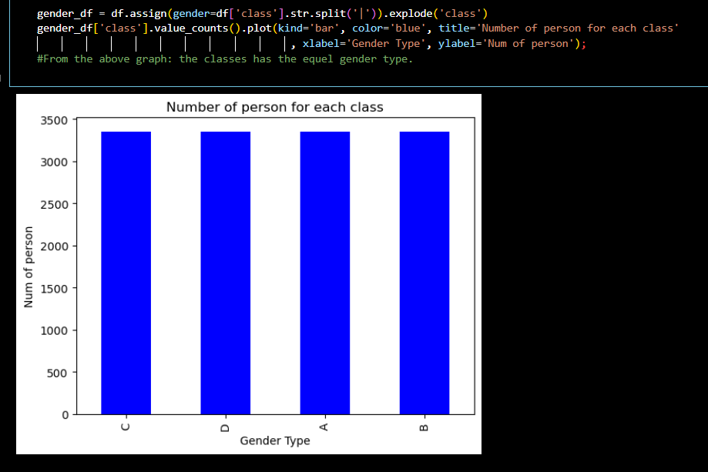
Visualization

Slide 20
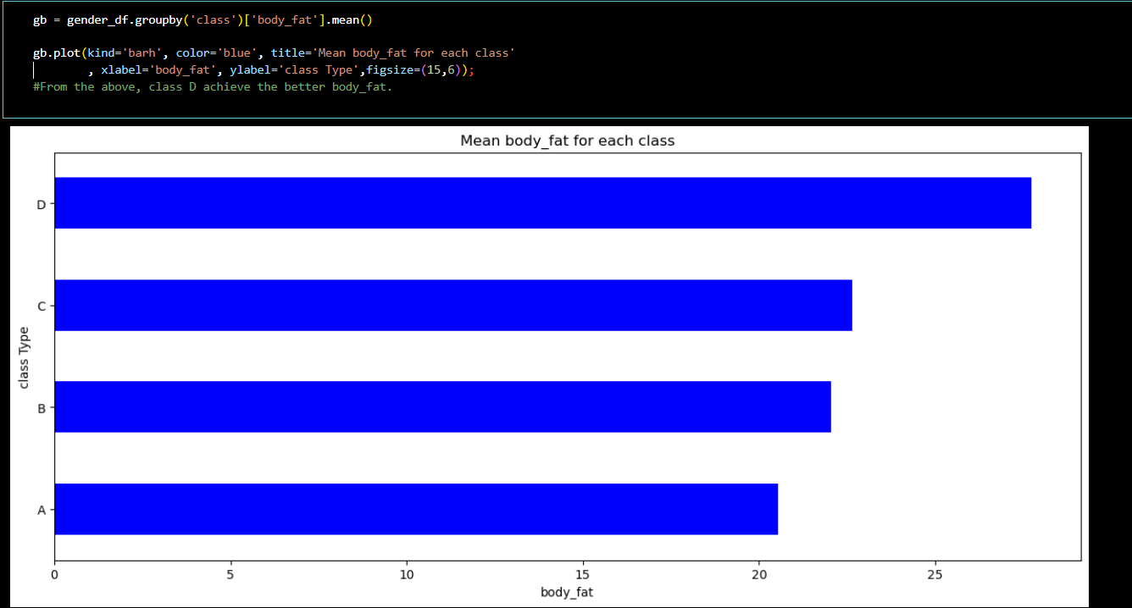
Visualization

Slide 21
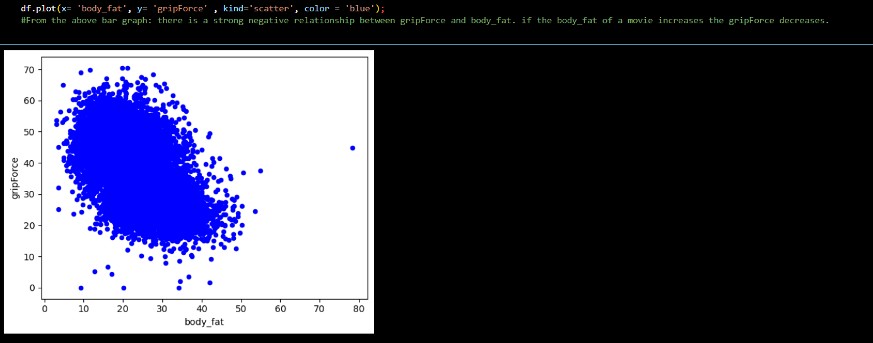
Visualization

Slide 22
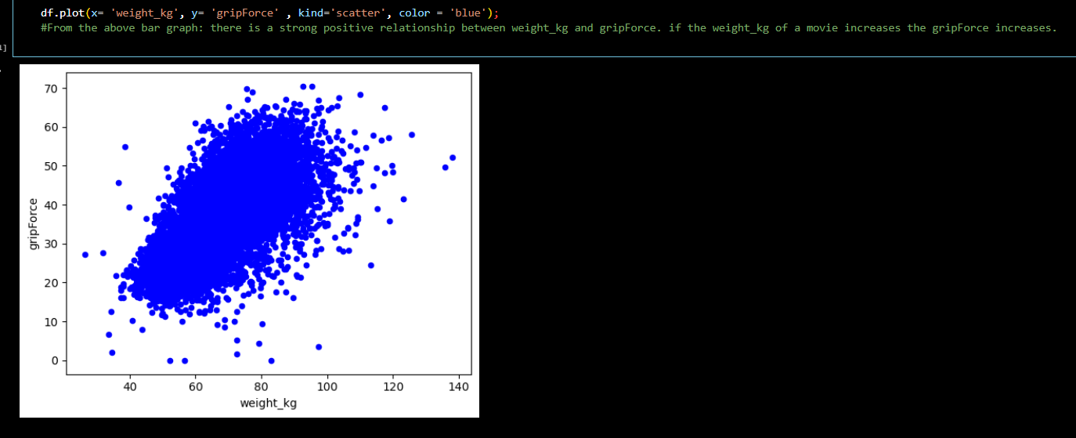
Visualization

Slide 23
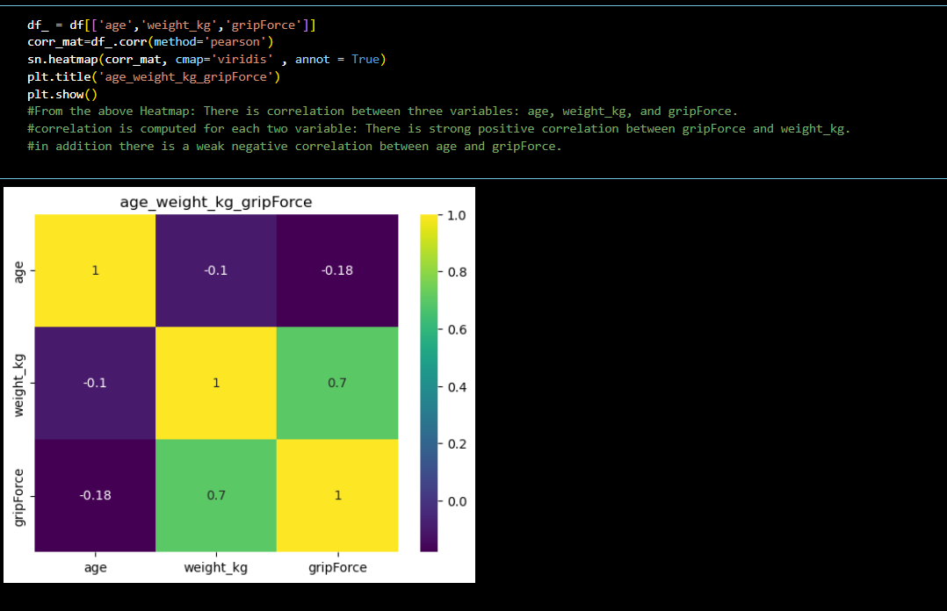
Visualization

Slide 24
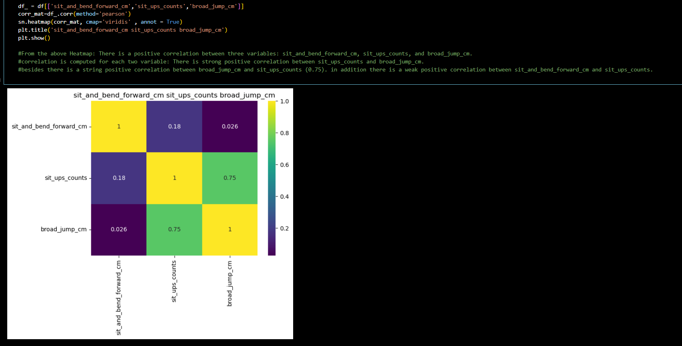
Visualization

Slide 25
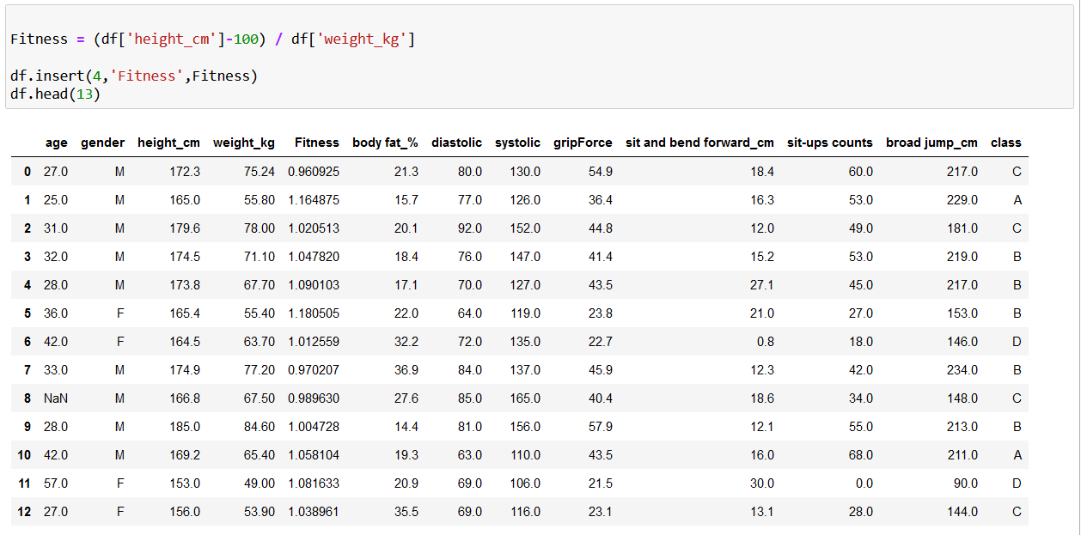
Exploratory Data Analysis
There is need foraFitness coulumnto be used in BMI Phase
Fitness=((height_cm)-100)/weight_kg

Slide 26
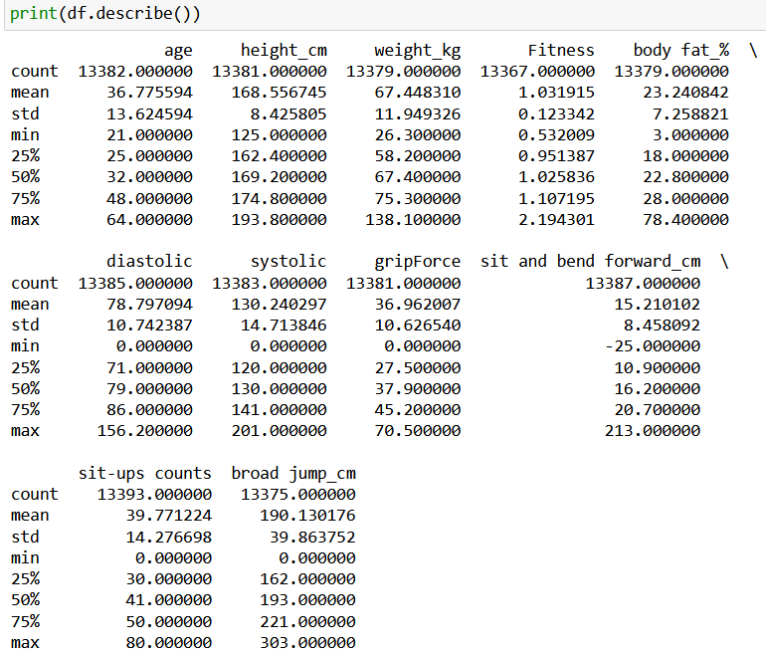
Descriptive Statistics about df
From the above result
we get some important
insights.
1-minimum age =21,
maxmum =64,
average=36.775594.
2-minimum height_cm =125,
maxmum = 193,
average=168.5567450.
3-minimum weight_kg =26.3,
maxmum = 138,
average=67.448310.
4-minimum broad jump_cm =0,
maxmum =303,
average=190.130176 .
5-minimum diastolic =0,
maxmum = 156,
average=78.797094 .

Slide 27
conclusions
This dataset is very rich in information. Some limitations the dataset contains are null and zero values in some features. These zero and null values hinders the analysis and have to be removed the rows that correspond to these zero and null values. Fore example null values is an obstacle which stopped me when I was analyzing the top casted actors. Furthermore zero values creates false results during the correlation plots and computing the person correlation

Slide 28
After the Exploratort Data Analysis we can conconclude
1-minimum age =21,
maxmum =64,
average=36.775594.
2-minimum height_cm =125,
maxmum = 193,
average=168.5567450.
3-minimum weight_kg =26.3,
maxmum = 138,
average=67.448310.
4-minimum broad jump_cm =0,
maxmum =303,
average=190.130176 .
5-minimum diastolic =0,
maxmum = 156,
average=78.797094 .
6-minimum systolic =0,
maxmum =201,
average=130.240297.
7-minimum sit-ups counts =0,
maxmum =64,
average=39.771224.
8-minimum gripForce =0,
maxmum =70.50,
average=36.962007 .
9-minimum sit and bend forward_cm =-25 ,
maxmum =213.00,
average=15.210102 .
10-minimum body fat =7.258821,
maxmum =78.40,
average=23.240842.

Slide 29
Some limitation are exist in this Dataset
1- Not null values , noisy data , incorrect datatypes. This all are processed in Data cleaning phase
2-Certain columns , like ‘age’ and ‘height_cm’ contain multiple values that we processing it
After that we have some result of data thas is make you preduct a solution for any any new inforation has a null columns

